Slide 1
World Happiness Report
Course End Project of DATA ANALYSIS AND
VISUALIZATION- 22ADE01
Submitted by
MOHAMMED ABDUL RAFE SAJID,
160123737051,
IT-1
CHAITANYA BHARATHI INSTITUTE OF TECHNOLOGY(A)

Slide 2
ABSTRACT
This project analyzes the World Happiness Report dataset from Kaggle to identify key factors influencing happiness across countries. Metrics include GDP per capita, social support, life expectancy, freedom, trust
in government, and generosity.
The analysis involves data cleaning, exploratory data analysis
(EDA), and visualizations using Matplotlib and Seaborn to uncover
trends and correlations. Statistical methods help pinpoint the most significant contributors to happiness.
Findings highlight that economic stability, strong social support, and low corruption are major drivers of happiness. Countries with higher GDP and better healthcare rank higher.
The project, conducted in Google Colab and documented on GitHub, offers insights for policymakers aiming to improve societal well-being.

Slide 3
Data Analysis & Mathematical Models
Techniques used:
Descriptive Statistics (mean, median, std. deviation)
Correlation Matrix
Scatter and Boxplots
Key Relationships:
GDP vs. Happiness Score
Social Support vs. Happiness Score
Optional Prediction: Linear regression model to
predict happiness scores (if implemented)

Slide 4
Libraries, Tools & Modules
Libraries:
pandas, numpy, matplotlib, seaborn
Tools:
Google Colab
Modules Used:
Data preprocessing: dropna(), fillna()
Visualization: pairplot(), heatmap(), barplot()

Slide 5
Data Visualization Tools & Techniques
Seaborn:
Pairplots, Barplots, Heatmaps
Matplotlib:
Histograms, Scatterplots
EDA Insights:
Happiness is positively correlated with GDP, social support
Regions like Europe score highest in happiness
Boxplots revealed regional disparities

Slide 6
Key Insights / Outcomes
Switzerland ranks highest in happiness
Economic indicators (GDP, life expectancy) show strongest correlation
Social support and trust in governance impact happiness positively
Countries with lower corruption tend to score better

Slide 7
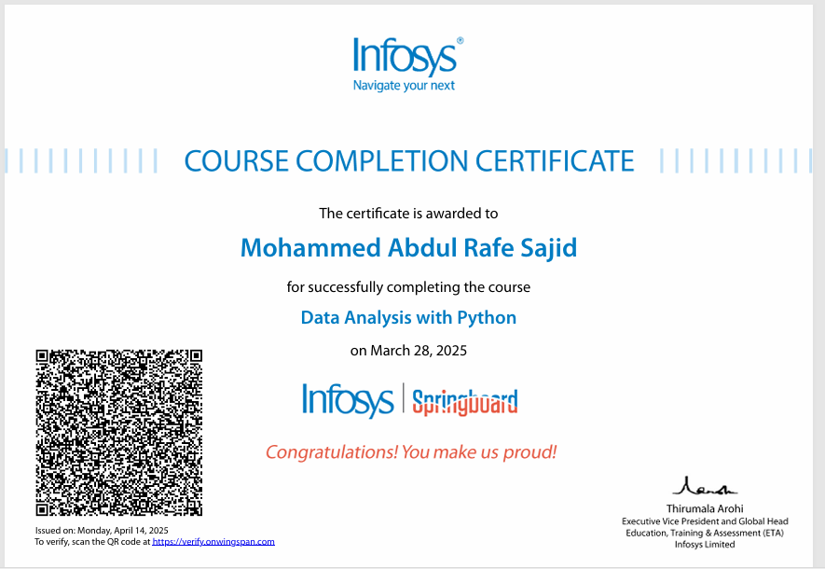

Slide 8
Summary & Conclusion
Cleaned and explored a real-world dataset effectively
Identified main contributors to happiness
Used statistical and visualization tools to derive conclusions
The study emphasizes the role of economic and governance factors in well-being

Slide 9
References
Kaggle Dataset: World Happiness Report
McKinney, W. – Python for Data Analysis
Hunter, J.D. – Matplotlib Documentation
Waskom, M.L. – Seaborn Documentation
Tukey, J.W. – Exploratory Data Analysis

